Slide 1
Course Name: Fundamentals of Plant Pathology
Course Code: 20013600
Mr. Vikash Kumar
(Assistant Professor)

Slide 2
Course Objectives
1: Name and identify different Diseases, nature of pathogens and different strategies for management of plant diseases.
2: Outline concepts, nomenclature, classification and characters of pathogens
3: Apply different principles and methods for plant disease management.
4: Take a part in identification of diseases and marketing of relevant pesticides.
5: Conclude methods to diagnose and manage a wide range of plant diseases.

Slide 3
Nomenclature, Binomial system of nomenclature, rules of nomenclature, classification of fungi. Key to divisions, sub-divisions, orders and classes.

Slide 4
Taxonomy and nomenclature of fungi
Taxonomy: The science of classification.
Classification: Grouping of organisms into classes, orders, families, genera, species etc.
Nomenclature: Art of naming of living organisms.
Importance of taxonomy and nomenclature;
1. for study of fungi
2. for scientific communication between mycologists and plant pathologists throughout the world.
Binomial system of nomenclature was originally introduced by Carl Linnaeus for higher plants. Later, this classification was adopted to fungi by his students C.H. Persoon and E.M. Fries (Linnaeus of mycology).

Slide 5
Some important rules of nomenclature :
1. According to International code of Botanical Nomenclature, the names of organisms should be binomial i.e., 2 parts.
The first part is noun designating genus and the first letter of the genus name should be in capital. The second name is often an adjective, which denotes the species, and the first letter should be in small letter. Eg. Puccinia graminis.
2. Binomials are usually derived from Greek or Latin.
3. Binomials when hand written should be underlined and when printed italicised. Eg. Puccinia graminis (hand written) Puccinia graminis (printed)
4. Citation of name: The full name or abbreviation name of scientist who described fungus first, follows the species name. Eg. Puccinia graminis Persoon or Pers.

Slide 6
5. Citation of two authors names: If name of species is transferred to another genus from original (Botrytis infestans), the name of first author who first described species must be kept in parenthesis followed by name of second author who gave present status of species. Eg. Phytophthora infestans (Mont.) de Bary.
6. The taxa (groups) used in classification are Kingdom, Phylum, Class, Order, Family, Genus and Species. Each category may be sub divided into sub groups like Sub- Division, Sub- Class and Sub-Order.
7. Species is the unit of classification or basic taxonomic category (taxon).
8. Species sometimes broken into variety/formae speciales (f. sp.) and varieties into races and races into biotypes.

Slide 7
Standard endings of TAXA:
Phylum ends with mycota
Sub- Division ends with mycotina
Class with mycetes
Sub- class with mycetidae
Order with ales
Family with aceae
No special ending for genus and species.

Slide 8
TAXA:
Kingdom
Phylum
Sub-division
Class
Sub-class
Order
Sub-order
Family
Genera
Species

Slide 9
Eg. Puccinia graminis tritici race 1
Kingdom: Fungi
Phylum: Basidiomycota
Sub-division: Basidiomycotina
Class: Teliomycetes
Order: Uredinales
Family: Pucciniaceae
Genus: Puccinia
Species: graminis
Variety: tritici
Race: 1

Slide 10
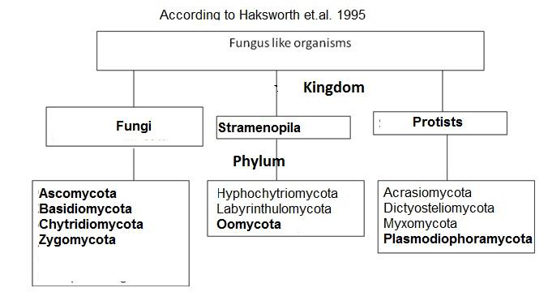
Classification of fungi
According to Haksworth et.al. 1995

Slide 11
1. Kingdom - Protists
Phylum- Acrasiomycota
Phylum- Dictyosteliomycota
Phylum- Myxomycota
Phylum- Plasmodiophoramycota
2. Kingdom - Stramenopila
Phylum - Hyphochytriomycota
Phylum - Labyrinthulomycota
Phylum - Oomycota
3. Kingdom-Fungi
Phylum - Ascomycota
Phylum - Basidiomycota
Phylum - Chytridiomycota
Phylum - Zygomycota

Slide 12
1. Plasmodiophoromycota:
These are obligate endoparasites. Commonly called as endoparasitic slime molds. Thallus is a plasmodium.
➢ Zoospores are anteriorly biflagellte, whiplash type.
➢ Members cause abnormal enlargement and multiplication of host cells i.e., hypertrophy and hyperplasia.
Eg: Plasmodiophora causes club root of crucifers, Spongospora causes powdery scab of potato.
2. Oomycota:
Thallus - mostly eucarpic, coenocytic. Also known as Water molds.
Cell wall consists of cellulose. Chitin is absent.
Asexual reproduction is by zoospores produced in zoosporangia. Zoospores are biflagelte (whiplash and tinsel)
Sexual reproduction is by gametangial contact (- Oogonium and + anthreidium) produce oospore.
Oospore is the sexual resting spore which is diploid.
Example:- Pythium, Phytophthora, Albugo Downey mildew causing fungi (Perenospora, sclerospora etc.)

Slide 13
3. Ascomycota:
➢ Produce definite number (usually eight) of sexual spores (ascospores) in a sac like structure called ascus.
➢ Mycelium is septate, branched and organized into tissues known as plectenchyma.
➢ Absence of motile spores and presence of asexual spores called conidia.
➢ Cell wall containing chitin.
➢ Example:- Powdery mildew fungi (Penicillium, Venturia).

Slide 14
3. (1) Imperfect fungi/Deuteromycetes:
➢ Thallus: septate mycelium.
➢ Motile spores are absent.
➢ Sexual spores are absent.
➢ Only asexual spores called conidia are present.
➢ Imperfect stage or anamorphic stage is present.
E.g. Fusarium, Alternaria
4. Basidiomycota:
➢ Thallus is septate mycelium.
➢ Motile spores are absent.
➢ Cell wall containing chitin
➢ Clamp connections and dolipore septum are present.
➢ Sexual spores are basidiospores produced specially 4 on club shaped basidium.
➢ Dikaryotic phase dominates the life cycle.
E.g. mushrooms (Agaricus), rusts (Puccinia) and smuts (Ustilago).

Slide 15
5. Chytridiomycota:
➢ Thallus unicellular or coenocytic mycelium.
➢ Zoospores are posteriorly uniflagellate whiplash type.
➢ Asexual reproduction is by zoospores produced in zoosporangia.
➢ Zygote is converted into resting sporangium / resting spore.
Eg. Synchytrium
6. Zygomycota:
➢ Absence of motile zoospores and production of non-motile sporangiospores (aplanospores).
➢ Well developed, coenocytic mycelium and cell wall with chitin.
➢ Asexual reproduction is by sporangiospores.
➢ Sexual reproduction produce of thick walled resting spore-zygospore.
E.g. Rhizopus, Mucor

Slide 16
Thank You

